Slide 1

Breast cancer detection
Presented By
Ujwal Nagulapalli,
Jyothsna Aitipamula

Slide 2
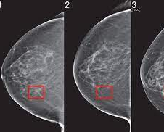
Introduction
Breast cancer can occur in women and rarely in men.
Symptoms of breast cancer include a lump in the breast, and changes in the shape or texture of the breast.

Slide 3

Objective
Main objectives of this project are
To identify the cancer in early stages by Deep learning.
To classify the types of breast cancer.
To make it easy for medical stuff to interpret the results easily and quick.
To decrease the death rate because of breast cancer to cure them on time.

Slide 4
Methodology
In this project we are targeting medical side by deep learning, that is to classify the images weather it’s belong to malignant or benign breast cancer patient. The whole pipeline will be discussed step by step
Input Data
Pre-processing.
VGG Classification.

Slide 5
Deliverables
Final Project Report.
AI Breast Cancer Classification Model.
Source Code.
Test Data.

Slide 6
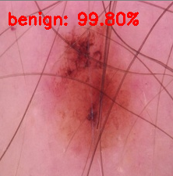
Evaluation Methodology
AI Model able to classify the type of breast cancer.
Classification is done at ease than traditional methods to detect breast cancer.
How accurately the model is predicting the given samples.

